Slide 1
Improving fuel consumption using EFI Technology for low-powered Motorbike Engine
Technical Seminar
by
ADARSH PRABHAKR
231039034
Embedded Systems
Under the guidance of
Panel Member 1: | Panel Member 2:
Mr . SATHYENDRANATH MALLI | Dr . B V RAVINDRA
Associate Professor | Associate Professor
Manipal School of Information Sciences | Manipal School of Information Sciences
MAHE, Manipal | MAHE, Manipal

Slide 2
Introduction
Objectives
Technology
Implementation
Results & Discussion
Conclusion
Limitations
References

Slide 3
Introduction
Small motorbikes usually in the range of 100 cubic centimetre(cc) to 250 cubic centimetre(cc) are widely used in many countries because of the convenience and good fuel economy
A survey made on motorbikes in 2001, registered 26 million motorbikes across the global.
Most of the motorbikes in developing countries use carburetor for mixing of fuel with air.
Carburetor motorbikes have so many drawbacks, such as higher fuel consumption, cold start problem, and many hazardous emissions.
The desire for increased fuel economy in conjunction with stringent emissions restriction has forced the automotive industry to make changes in the spark-ignition engines.

Slide 4
Introduction
Therefore, an Electronic Fuel Injection(EFI) system was developed which is an efficient system for controlling and supplying optimal amount of fuel to the combustion chamber.
Its capabilities include better fuel economy, better cold starting capabilities, lower outputs of exhaust emissions, good vehicle drivability and performance.

Slide 5
Objectives
Reduce Fuel Consumption
Increase Fuel Economy
Eliminate Cold Start problem
Reduce high emissions
Improves good drivability

Slide 6
Technology
This study proposes the application of using fuel injection system for low powered motorbikes.
This method reduces fuel consumption, elevate performance and eliminates so many problems.
This system is based on injecting fuel in air stream by sensing engine condition from various sensors through electronic means.
This paper also discusses different factors that are required to control quality of fuel in airstream for max fuel efficiency.
The mathematical background, material and technology, performance testing procedure and test results will be discussed in the following sections.

Slide 7
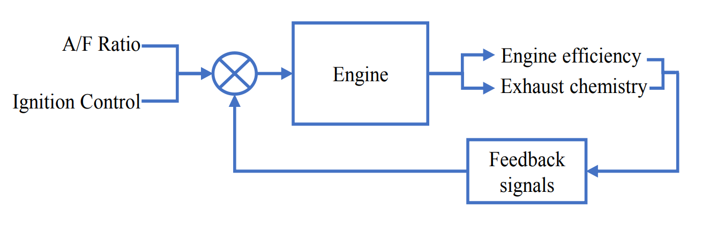
Technology
Closed-Loop Control Approach
In this system, a closed-loop control approach is used to meet the requirement of A/F ratio control as well as emission control.
Engine outputs as power, torque and exhaust chemistry are used as potential controllers for the A/F ratio and ignition timing.

Slide 8
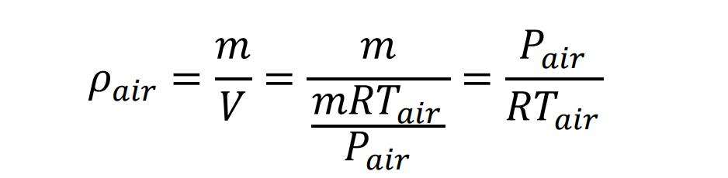
Technology
Mathematical Background
Speed Density Model
Speed density model is used which calibrate the engine as an air pump and in this case, intake density and pump efficiency are know as a function of speed and load.
Air mass along with relative air change(load) is calculated to get a basic fuel pulse width.
Intake air density is calculated by using ideal gas law,

Slide 9

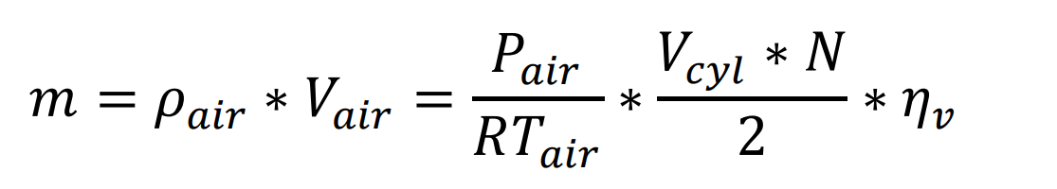
Technology
The intake air volume is a function of volumetric efficiency and calculated for each by using,
= Volumetric efficiency
The mass of the air entering in the engine is calculated by using,

Slide 10
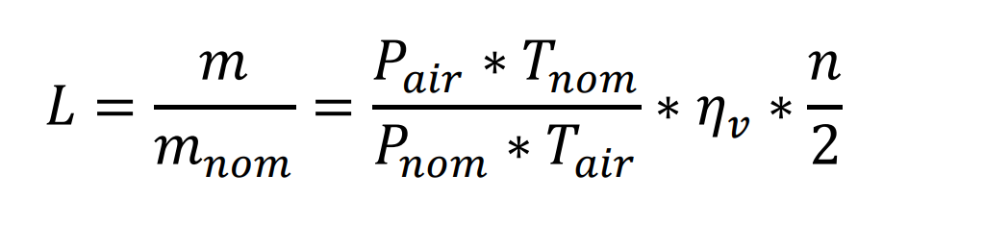
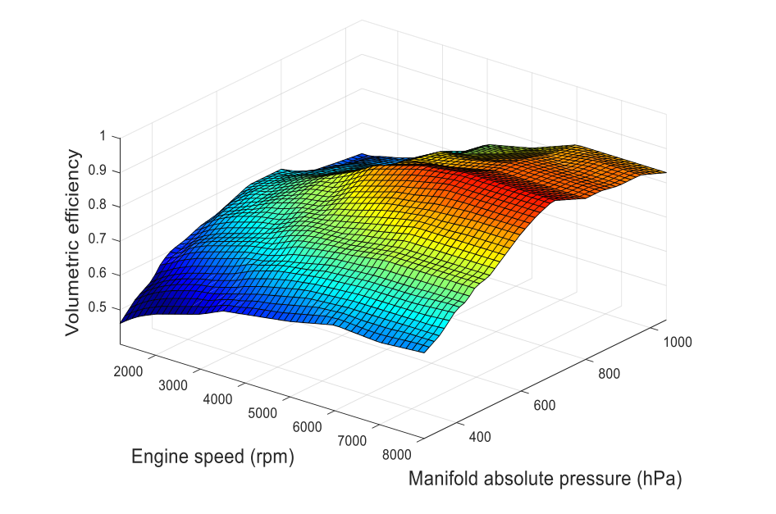
Technology
In order to calculate relative air change(engine load), the air mass is divided by nominal cylinder air mass which is the mass of cylinder when it is the bottom, at standard air temperature and pressure.

Slide 11
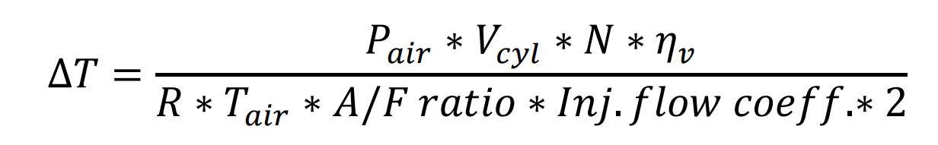
Technology
B. Fuel Injection Pulse Width
The fuel pulse width is calculated by using that of air as per following,
A/F ratio – the ratio of air with fuel.
Inj. Flow coeff. – correction factor used for the variation of temperature.
The final pulse width is composed with basic fuel pulse width along with different correction factors and it is calculated,

Slide 12
Technology
- Global fuel enrichment factor
- Start Correction factor
- After Start correction factor
- Warm-up correction factor
- Closed-loop correction factor
- Battery voltage correction factor

Slide 13
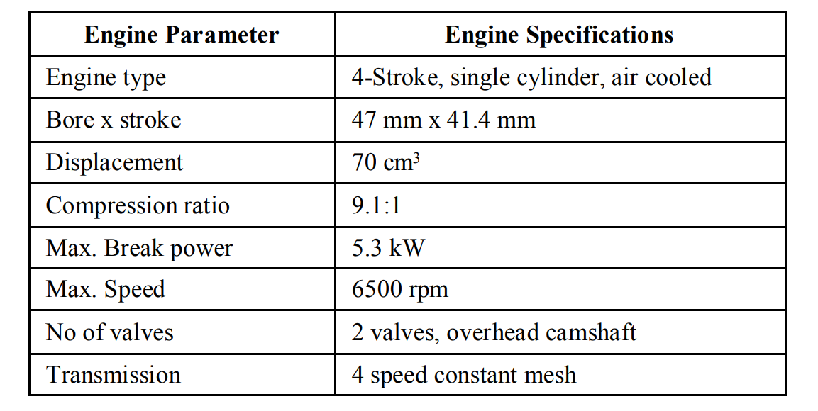
Implementation
Schematic Setup
The above shows the specification of the engine, which is used for this experiment.
The EFI system is applied in the place of carburetor and a program for the basic calibrations of A/F mixture is burned in the electronic control unit(ECU).
A logic element is set in ECU to process different sensors output voltages and its basic calibrations are modified by using result signals.

Slide 14
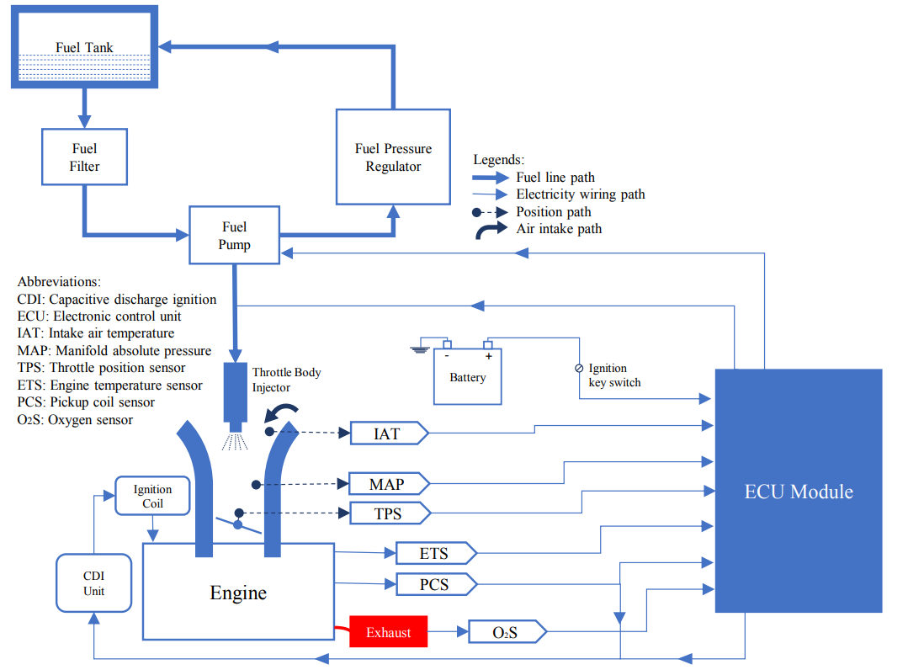
Implementation
Schematic Setup

Slide 15
Implementation
The fuel delivery system includes an electronic driven turbine style fuel pump, a fuel filter, single cylinder fuel injector, a vacuum operated fuel pressure regulator to maintain the pressure and supply and return lines.
The pressure regulator maintains that constant pressure and bleeds the excess fuel, which is not required for the engine operation.
The air induction system includes the throttle body, which is made of iron cast, and enclosed throttle position sensor(TPS), fuel injector and manifold absolute pressure(MAP) sensor.
INPUT SIGNAL COMPONENTS
The input signal components include sensors that give input to the ECU to judge the working condition of engine for A/F ratio control.

Slide 16
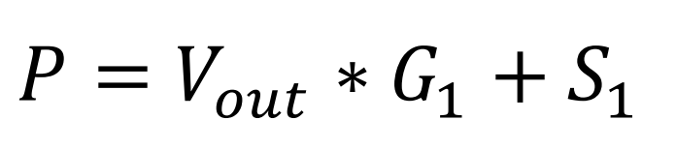
Implementation
MAP Sensor ( Manifold Absolute Pressure)
The MAP sensor is used to monitor the engine load and dynamic manifold pressure through vacuum created by the section of engine.
It is a variable resistor assembly with voltage signals variation from 0.5V at 20kPa to 4.9V at 103kPa.
The conversion of analog signals from MAP sensor into pressure is a linear change given in the equation
G1 the slope
S1 is the offset value
P is the manifold pressure(hPa)

Slide 17
Implementation
ETC Sensor ( Engine Temperature Coefficient)
The two temperature sensor used are thermistors having negative temperature coefficient(NTC 1).
It is fitted on the cylinder head of the engine where heat is mostly reflecting the intake air temperature.
IAT Sensor ( Intake Air Temperature)
NTC 2 is the intake air temperature(IAT) sensor installed om the airstream flow path, and is used to measure the air temperature.
NTC 1 is the key component in achieving the wholesale enrichment that is needed to overcome “cold start” problem.

Slide 18
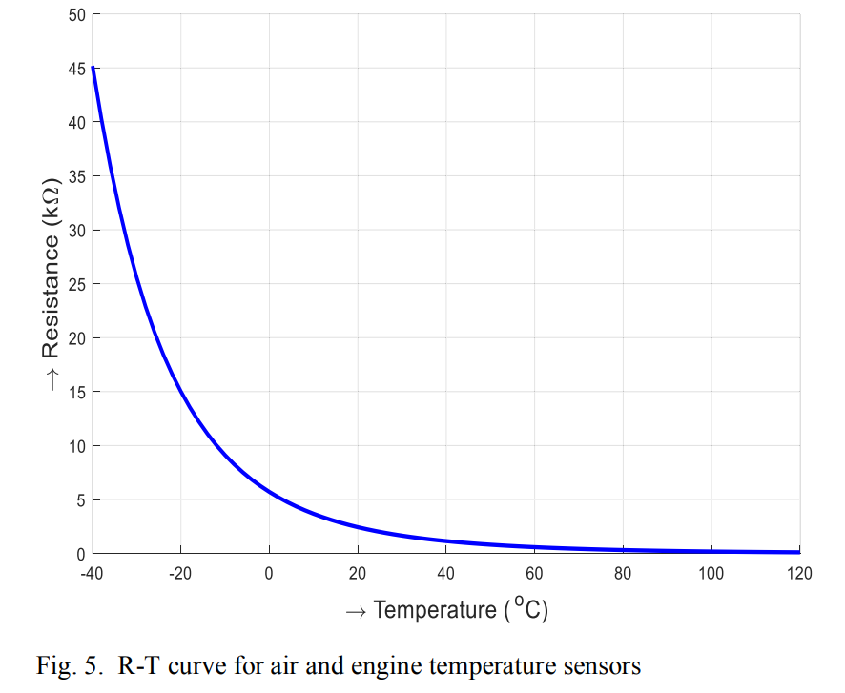
Implementation
TPS Sensor ( Throttle Position Sensor )
The value position is detected in order to maintain the air entering the engine. Its voltage varies linearly from 0.45V to 4.5V w.r.t throttle angle.
If the driver suddenly accelerates, the ECU will consider this as 4.5 V signal and increase the fuel injector pulse-width to compensate for the amount of air entering.

Slide 19
Implementation
CPS Sensor ( Crankshaft Position Sensor )
For precise control on ignition timing, the crank angle should be accurately detected. The system detects the crank angle directly from the crank rather than from other half speed shafts, which can introduce errors due to backlash.
The crankshaft position sensor(CPS) is used for this purpose. It’s a magnetic pickup coil sensor that is attached to the pickup signal of the spark plug.
Thus providing the speed information and the position of the crankshaft for spark plug ignition.
Oxygen(lambda) Sensor
Oxygen sensor provides information about the presence of oxygen in the exhaust gases.
Its potential varies abruptly from 900mV at rich A/F ratio(λ<1) to 100mV at lean A/F ratio (λ >1) according to the Nernst equation.

Slide 20
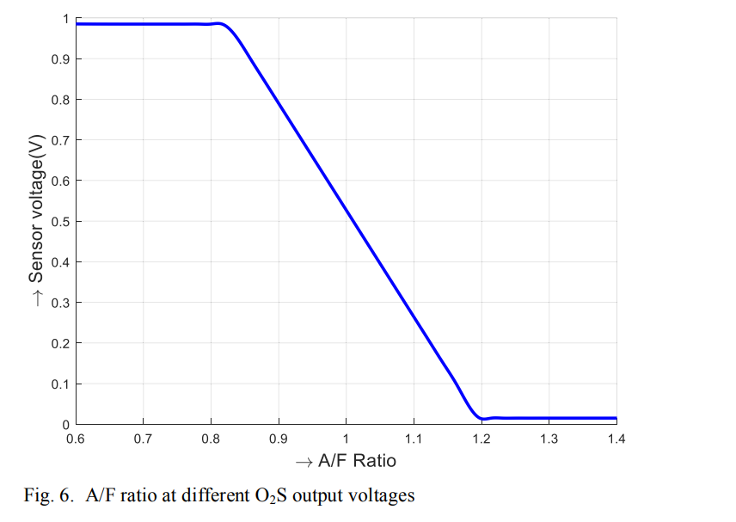

Implementation
Approx. 20 to 30 seconds are required for the oxygen sensor to be heated at threshold temp. of 300 degree C before its operation.
Its will not give feedback until the threshold is reached.
So during engine start-up and warm-up operation, the fuel delivery system works in open-loop mode and operates by a selected engine start-up and warm-up fuel factors and falls on the set of internal “maps” until the required temperature reached.

Slide 21
Implementation
PROCESS CONTROL AND CALIBRATION COMPONENT
The process control and calibration unit consists of ECU, portable connection socket and harness for communication.
ECU which is used, is actually 20-pin microprocessor that includes application specific integrated circuits or ASIC chips and read vehicle parameters from different sensing devices mounted on the engine.
It is integrated with self-learning and return type fuel injection system modes that calculate the amount of fuel and ignition timing for an internal combustion engine to keep running.
It consumes less than 60mA of current and 9V to 16V DC voltage supply.

Slide 22
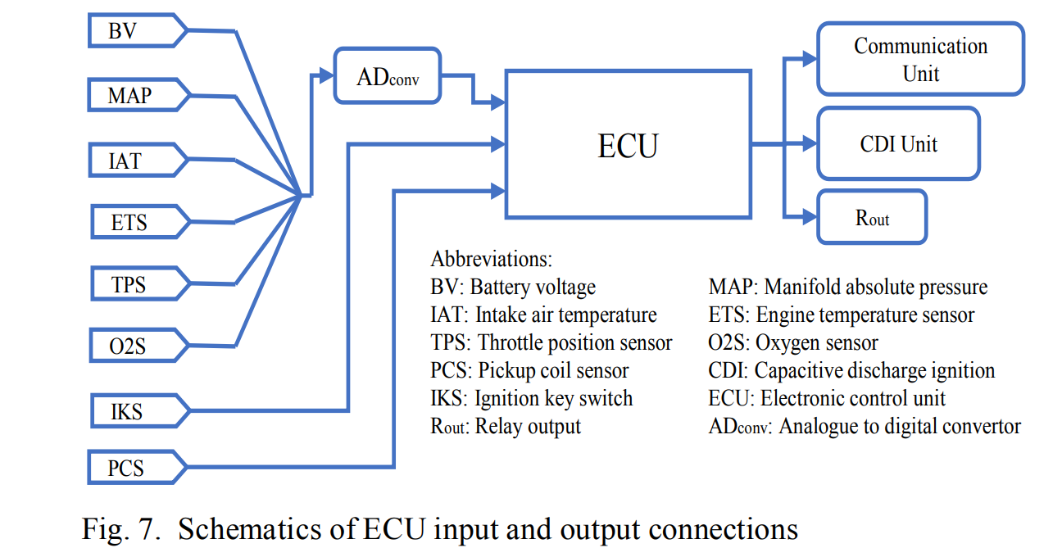
Implementation

Slide 23
Implementation
EFI PERMORMANCE PARAMETER
After the assembly of the EFI on bike engines, the next step is to monitor its performance. Which includes engine specifications, idle condition and wide open throttle calibration fuel and altitude factors.
Overall fuel enrichment factor depends on three factors
Start Factor
After-start Factor
Warm-up Factor
The Fuel enrichment factor in our case is 1.2 for before start condition and 1 for all other operating conditions

Slide 24
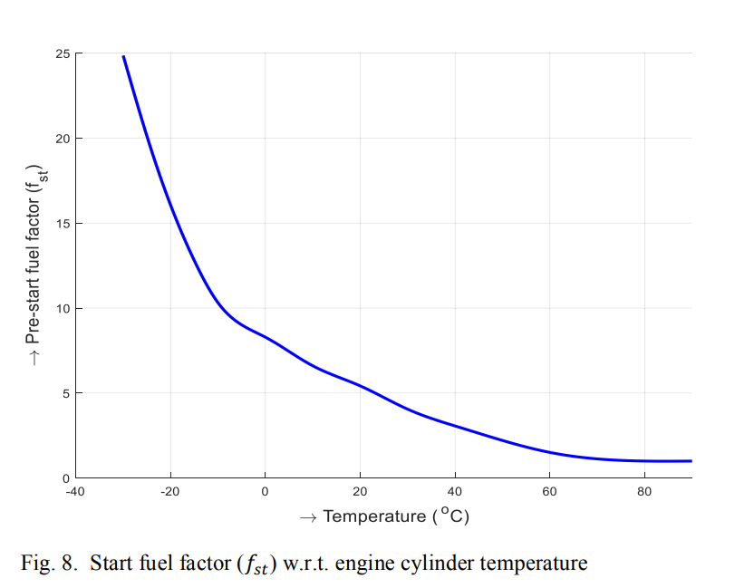
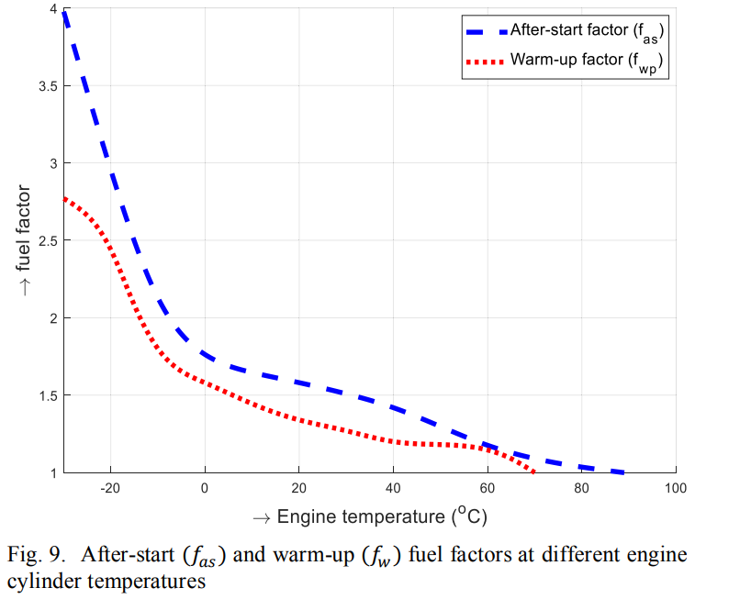
Implementation

Slide 25
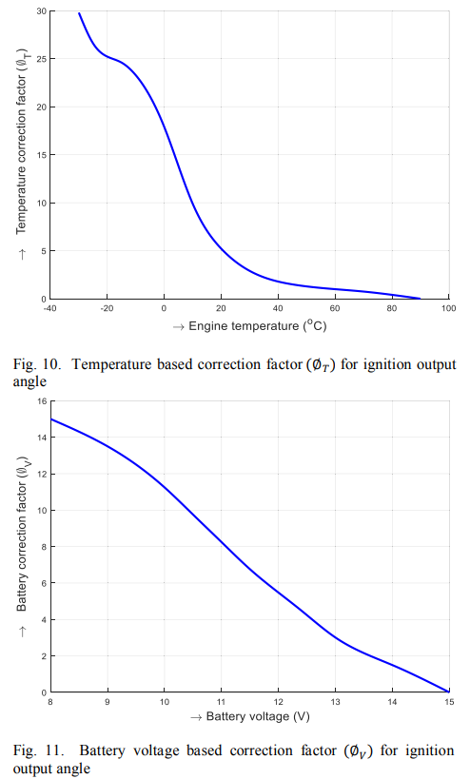
Implementation

Slide 26
Results and Discussion
EFI Performance Testing Procedure
The performance was monitored at idle condition plus in a set of 4 different test points.
The Engine performance parameters from different sensors were noted down after covering the distance of 4 km in different 4 rpm conditions.
Taken one liter of fuel to check the mileage of the bike for both carburated engine and EFI engine system.
The whole experiment of mileage included sudden acceleration and decelerations with a varying range from 25 km/h to 55 km/h, brakes and WOT conditions

Slide 27
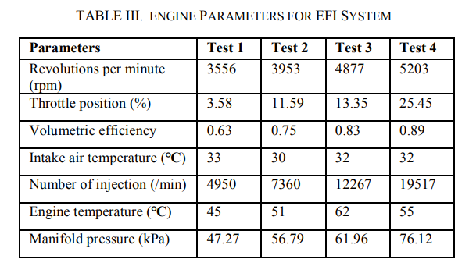
Results and Discussion
By using 1 liter of fuel with a carburetor assembly, a mileage of 55 km has observed.
With same engine condition and load for EFI system, a mileage of approx. 64 km has observed.
This gives an increase of 9 km per liter more mileage that is equal to the 16.36% increase in the fuel efficiency for specified baseline vehicle.

Slide 28
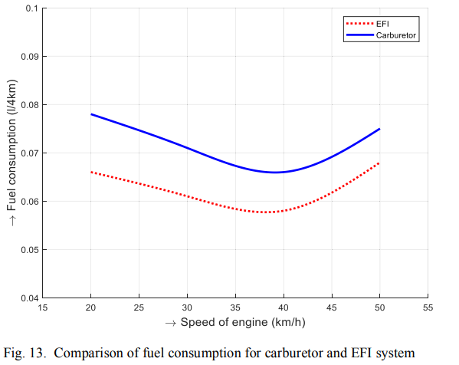
Results and Discussion

Slide 29
Conclusion
This system eliminates the use of choke valve.
Improved performance and drivability.
Result had shown 13 % increase in the avg fuel saving for most of the speed range.
Fuel efficiency calculated around 16.4 % on road test. Approx. increase 9 km per liter.
Eliminate the cold start problem.
Reduce High emissions.

Slide 30
Limitations
This method is only suitable for the low rpm and loading conditions because MAP sensor has limited resolution.
Small engine manifold pressure changes so dynamically that there are no stable constant MAP signals for specific case.
To overcome this problem, this method needs to be blend with Alpha N method( TPS based load method ) to get best engine control at low and high rpm conditions

Slide 31
Limitations
M. T. Muslim, H. Selamat, A. J. Alimin, N. M. Rohi and . M. F. Hushim, "A review on retrofit fuel injection technology for small carburetted motorcycle engines towards lower fuel consumption and cleaner exhaust emission," Renewable and Sustainable Energy Reviews, vol. 35, pp. 279-284, July 2014.
T. S. Lai and H. Gitano-briggs, "Development of a Small Motorcycle EFI Retrofit System," 2009.

Slide 32
Queries
&
Suggestions

Slide 33
THANK YOU…

